Slide 1
Providing affordable support services to independent practices
Colorado-Based Independent Practice Association located in Denver, CO

Slide 2
Practice Health Network
About Us
Rose Medical Group (dba Practice Health) is an Independent Practice Association (IPA) serving the Denver-Metro area.
Our network is comprised of primary care and specialty care providers that join together to access major healthcare company insurance contracts, credentialing services, and discounted group purchasing (CollaboRATE).
720+ Providers
60% Specialist
40% Primary Care
242 Practices
54 Provider Specialties
48 Practice Specialties

Slide 3
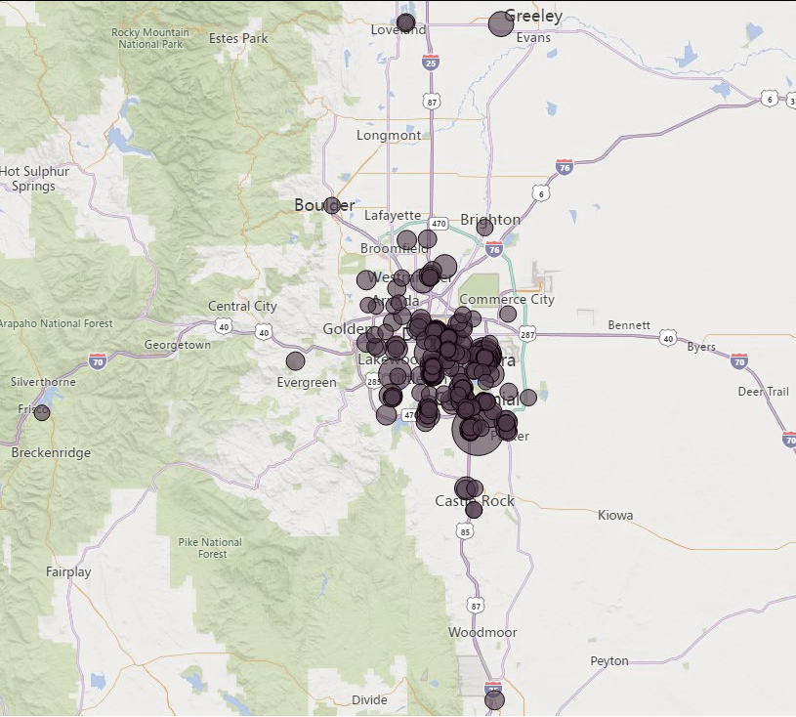
Allergy/Immunology Anesthesiology Bariatric Medicine Behavioral Health Cardiology Colorectal Surgery Critical Care/Intensivists Dermatology Emergency Medicine Endocrinology Family Medicine Gastroenterology General Practice Gynecology
Hand Surgery Hematology/Oncology Hospitalist
Infectious Disease Internal Medicine Medical Oncology Medical Toxicology Neurology Neuromusculoskeletal Neurosurgery Obstetrics/Gynecology Occupational Medicine Ophthalmology Orthopedic Surgery Osteopathic Manipulative Therapy
Otolaryngology Pain Management Pathology
Pediatric Endocrinology Pediatric Gastroenterology Pediatric Hematology Pediatric Neurosurgery Pediatric Pulmonary Medicine
Pediatric Rehabilitation Medicine
Pediatrics
Physical Medicine and Rehabilitation
Plastic and Reconstructive Surgery Podiatry
Professional Counselor Pulmonary Medicine Radiology Reproductive Endocrinology Rheumatology
Sleep Medicine Surgery Urgent Care Urogynecology Urology
Vascular Surgery

Slide 4
What We Do
Contracting Services
Access to join 10 fee-for-service and Medicare Advantage payer contracts with over 30 + networks
Aetna | Anthem | Clear Spring Health | Cigna Colorado Access | Devoted Health | First Health | Humana
MultiPlan/PCHS
Support with claim escalations and payer relations
Other Services
Education
Maintenance of CAQH accounts
Assist and review completion of all mandatory, payer-specific credentialing paperwork
Assist with notification to payers of practice changes, such as address changes and provider terminations
Credentialing status tracking and bi-monthly email follow-up to the practice
CollaboRATE - group purchasing through Advantage Trust and preferred vendors
Monthly newsletters with payer, network, and CME information
Access to HIPAA/OSHA training
Educational webinars
Lease contract savings
Medical billing and coding services
Revenue collection
Marketing for small healthcare practices
Fees: $450 One time Credentialing Fee | $750 Provider Annual Dues

Slide 5
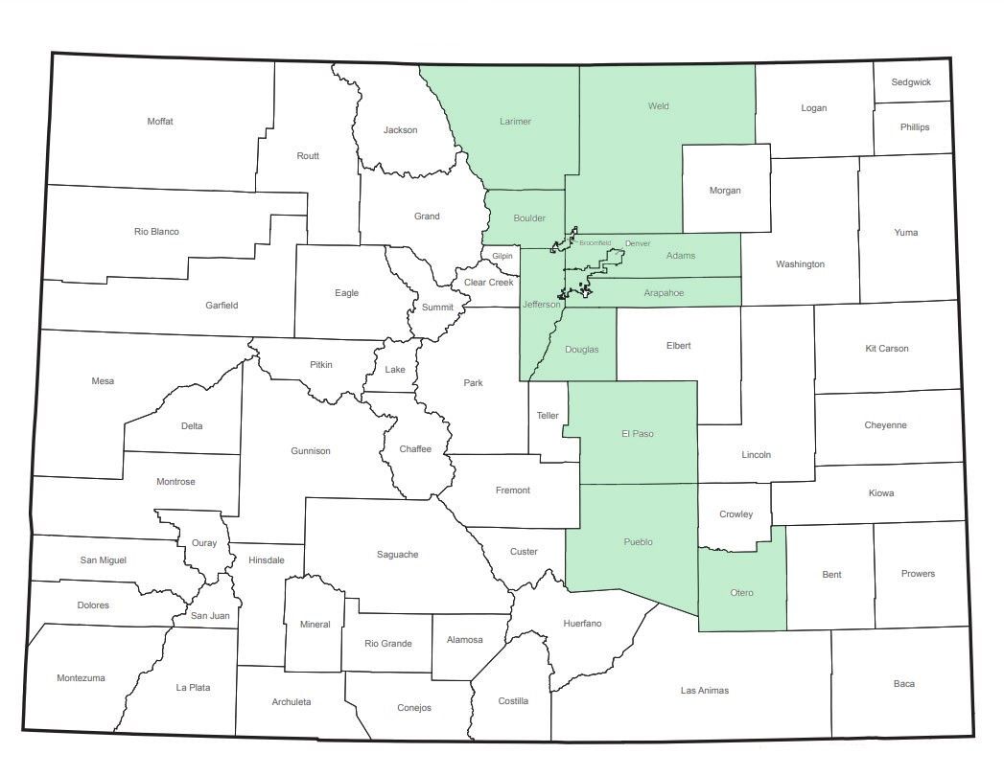
Practice Health Contract Service Areas
Contracts that are active in specific counties in Colorado
Clear Spring Health: Adams, Arapahoe, Broomfield, Boulder, Clear Creek, Douglas, Denver, El Paso, Gilpin, Jefferson, and Pueblo
Devoted Health: Adams, Arapahoe, Broomfield, Boulder, Douglas, Denver, Elbert, El Paso, Jefferson, Larimer, Park, Teller, and Weld
Contracts that are active and cover the State of Colorado
Aetna
Anthem
Cigna
Colorado Access
First Health
Humana
Map above represents counties with active Practice Health membership
5
MultiPlan/PHCS follows the coverage of the plan the network is representing

Slide 6
New Practice Intake Process
Practice Health will email the Practice
Practice Intake Form
Requires Practices legal name and DBA along with Primary address and all locations addresses
W-9
Insurance Selection Grid
Indicates which contracts you would like to join through Practice Health
All Medicare Advantage plans need active Medicare enrollment and Medicare ID
CO Access requires active Medicaid enrollment and Medicaid ID
All applications are submitted within 5 business days of application completion and fee payment.
*The credentialing process will not begin until Practice Health receives a signed Practice Health Participation Agreement, credentialing documentation, payment of the credentialing fee

Slide 7
New Provider Application Process
1. Initiate New Provider Application
Things to Note
Email the Practice Health inbox with:
Provider name and provider email
CAQH login information (username and password)
Admin profile(s) to connect to the application
For any office administrator(s) that will help or support the provider in completing the credentialing application
Practice Health recommends having the following items ready before starting the application
CV
Board certification(s)
CO state license
CO DEA license (or DEA arrangement)
Professional liability insurance (with provider and practice name listed on the policy)
Once the provider’s application is completed and submitted to applicable payers, the practice will received a prorated annual dues invoice, due within 30 days of receiving the invoice.
It can take up to 120 days to gain effective dates from applicable payers. Payers require at least 60 days prior to Practice Health submitting inquiries.
All credentialing fees and annual membership dues are non-refundable.
2. Complete Online Application
Application completed through Verity CredentialStream
3. Pay Invoice
Invoice sent through QuickBooks. Pay either by:
Electronic payment using Practice Health’s payment portal
Paper check mailed to the Practice Health office

Slide 8
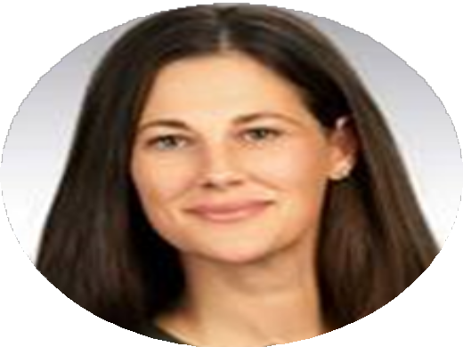
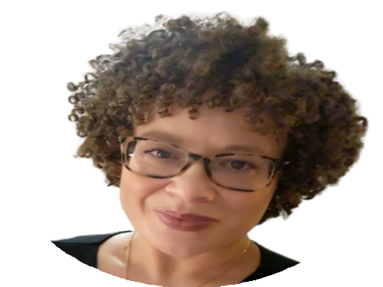
Meet the Team
Leadership Team
Jacque Terrasi
Vice President Practice Health
Lisa Rothgery, MD
Chief Medical Officer
Katie Woodward
Administrative Director, Operations
Physician Liaison Team
Credentialing Team
Lanye Banks
Physician Liaison
Ashley Sayers
Credentialing Supervisor
Brandon Boyd
Credentialing Coordinator
Zach Williamson
Credentialing Coordinator
8
Notes:
We have a small but mighty team here at Practice Health.
Though the board of directors ultimately leads and sets the direction for the IPA, Jacque Terrasi was appointed the VP of PH in June of 2022. Jacque has been instrumental to the revitalization and growth of PH over the years, working with and alongside the IPA since 2021 in various roles. Dr. Lisa Rothgery is PH’s Medical Director, since 2020 (member of PH for over a decade). She helps be the voice of the practitioner on the leadership team and provides me and Jacque great support as we execute on the BOD’s strategy and direction.
Lanye Banks serves as our Physician and Provider Liaison for Practice Health. I often describe Lanye as the external engine of PH – she is responsible for meeting with practices, escalating your issues, and connecting you with member benefits such as discounts and peer-to-peer connections.
- Discussion question: with a show of hands, how many of you have personally met with Lanye this year?

Slide 9
Stay in touch
4900 S. Monaco St., Suite 240, Denver, CO
Practice.Health@HCAHealthcare.com
303.584.6231
practice-health.com
@practicehealthipa

